Slide 1
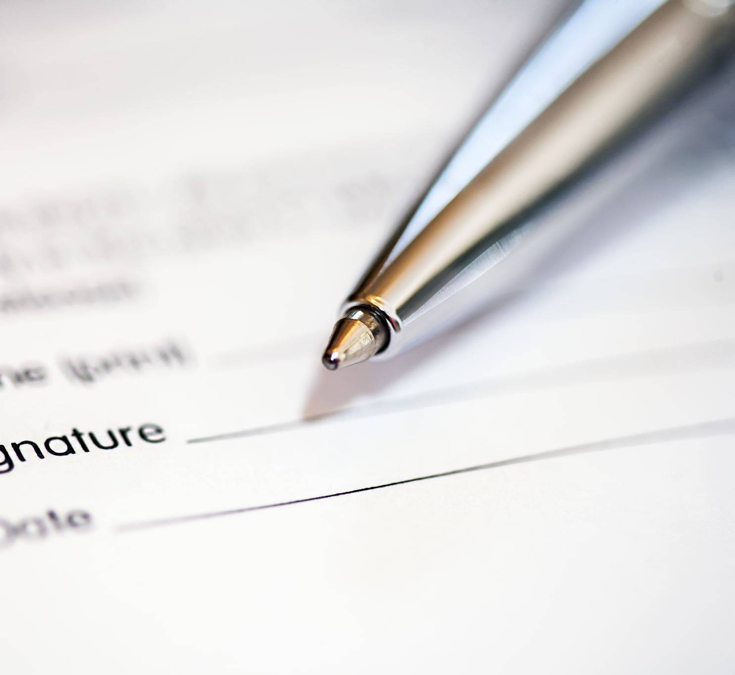
Smart Contracts
Naman Sharma

Slide 2
This course is for someone:
Who does not know much about:
Blockchains
Smart contracts
Rust
Near eco-system
JavaScript
If this person is not you, then please check out the near documentation as that will be a faster way you to learn!!

Slide 3

What is a blockchain?
Think of a blockchain as a special kind of database stored across a network.
A database that is:
Distributed (all network participants have a copy)
Immutable (past entries cannot be changed)
Agreed upon by all participants (both past and future entries) through a consensus

Slide 4
What is a Smart Contract?
Smart contracts are programs stored on a blockchain
Smart contracts are used to execute an agreement (or parts of an agreement) when certain conditions are met
If we are trying to buy an NFT, what will this agreement look like?
What are the pre-conditions?
What will the smart contract code do/ what will the outputs?

Slide 5
Smart contract use cases:
When thinking about how to use a smart contract?
Think about what the smart contract will know!
It will have visibility over the whole blockchain and be able to execute code immediately.
For example:
If my blockchain stores data on insurance payments being made by farmers for their land with data on where their land is and how much the land is worth
We can write a smart contract to immediately execute insurance pay outs given we have extreme weather or conditions that affect our crop yield
No need for middle-men to validate insurance pay outs and take premiums

Slide 6
Can you think of some use cases?
Some ideas to get you started:
Buying/selling assets (digital and physical – tied with NFT)
What happens if I cannot afford the asset in its full price?
Gaming industry (play to earn)
Medical industry
And many more – up to you to find them!
Notes:
Think of secondary/tertiary markets – easier to price goods
Fractional ownership
Medical industry : In healthcare, archival data of patients needs to automatically become immutable and accessible only to specific researchers – especially for clinical trials
centralised databases to allow for cross border trtials

Slide 7
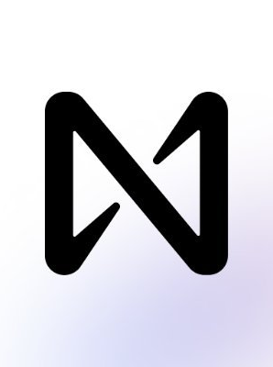
Near: a Blockchain , Ecosystem and Foundation

Slide 8
The Near Network
Near is a carbon-neutral, layer 1 blockchain
Layer 1 blockchains offer validation and execution of transactions without support from other networks, their focus being scalability: offering the most transactions per second
Pros of Near:
Scalability via Sharding
Interoperability

Slide 9
Rust vs smart contract programming languages

Slide 10
Donation Smart Contract
Repo:

